Slide 1
Ch.7 Terahertz Imaging
Lee Jong Geon

Slide 2
Contents
Image Resoultion of a Terahertz Imaging System
Data Analysis in the Far Field
Imaging Thin Layers
Spatial Resolution Tests
Near-Field Imaging
Chemical Imaging
Focal Plane Array Microbolometer Cameras

Slide 3
Image Resolution of
a Terahertz Imaging System

Slide 4
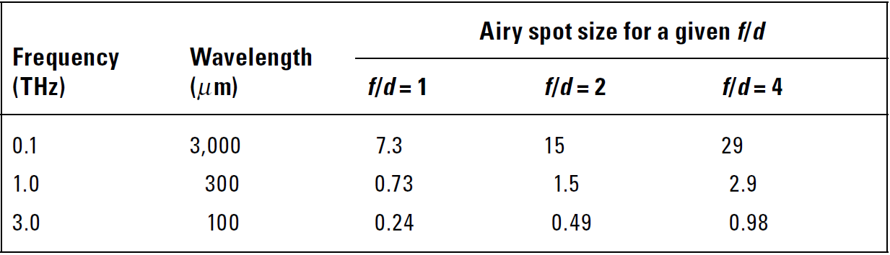

1. Image Resolution of a Terahertz Imaging System
Both spatial and depth resolution depends on the frequency and the optical design.
Spatial Resolution (Airy spot)
f-number
$$D_{Airy}=2.44\frac{f}{d}$$
Depth Reslotion
The shorter the pulse, the higher, in theory, is the resolution.
The majority of materials tend to suffer stronger absorption.

Slide 5
Data Analysis in the Far Field

Slide 6
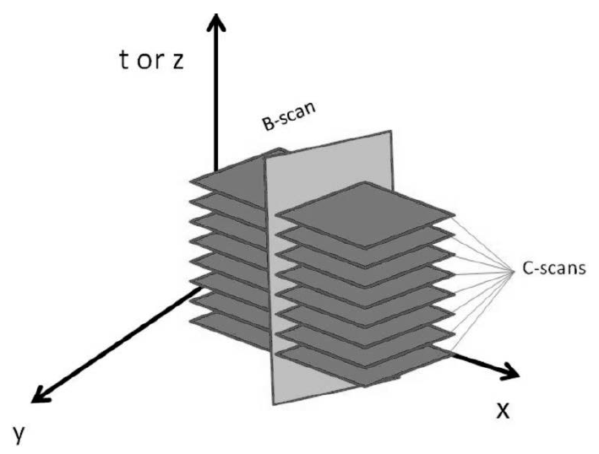
2. Data Analysis in the Far Field
The time-domain signal is recorded individually for each point and the image is formed by raster-scanning the object.
A-scan: point scan
B-scan: line scan
C-scan: area scan

Slide 7
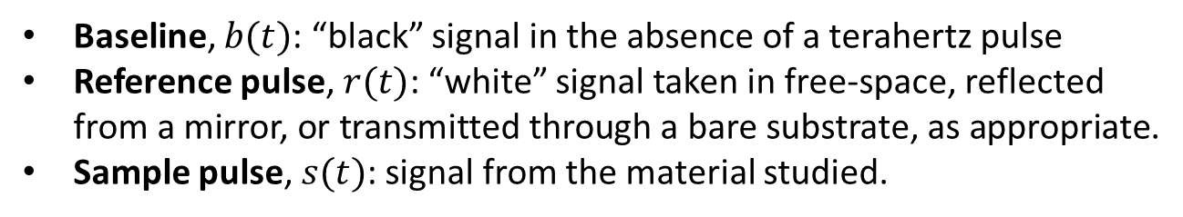
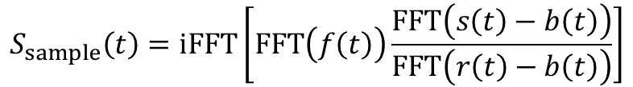

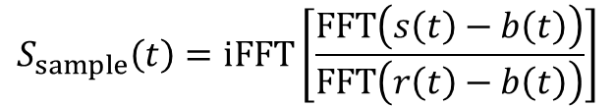
2. Data Analysis in the Far Field
$$S_{sample}\left(t\right)=iFFT\left[\frac{FFT\left(s\left(t\right)−b\left(t\right)\right)}{FFT\left(r\left(t\right)−b\left(t\right)\right)}\right]$$
Baseline, $b(t)$: “black” signal in the absence of a terahertz pulse
Reference pulse, $r(t)$: “white” signal taken in free-space, reflected from a mirror, or transmitted through a bare substrate, as appropriate.
Sample pulse, $s(t)$: signal from the material studied.
$$f\left(t\right)=\frac{1}{HF}e^{−\frac{t^{2}}{HF^{2}}}−\frac{1}{LF}e^{−\frac{t^{2}}{LF^{2}}}$$
$$S_{sample}\left(t\right)=iFFT\left[FFT\left(f\left(t\right)\right)\frac{FFT\left(s\left(t\right)−b\left(t\right)\right)}{FFT\left(r\left(t\right)−b\left(t\right)\right)}\right]$$
Aenchbacher, W., M. Naftaly, and R. Dudley, “Line Strengths and Self-Broadening of Pure Rotational Lines of Carbon Monoxide Measured by Terahertz Time-Domain Spectroscopy,” Applied Optics, Vol. 49, No. 13, 2010.

Slide 8
Imaging Thin Layers

Slide 9
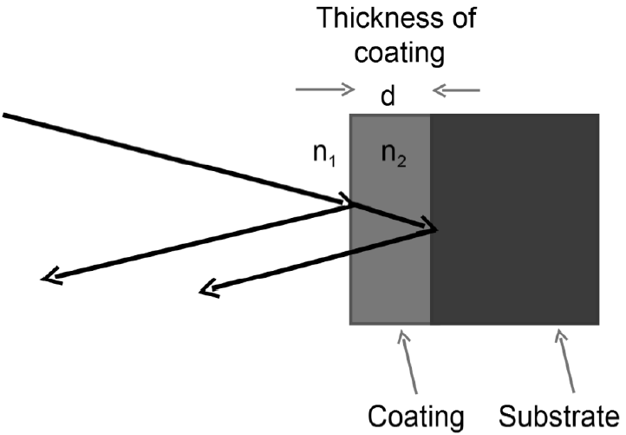
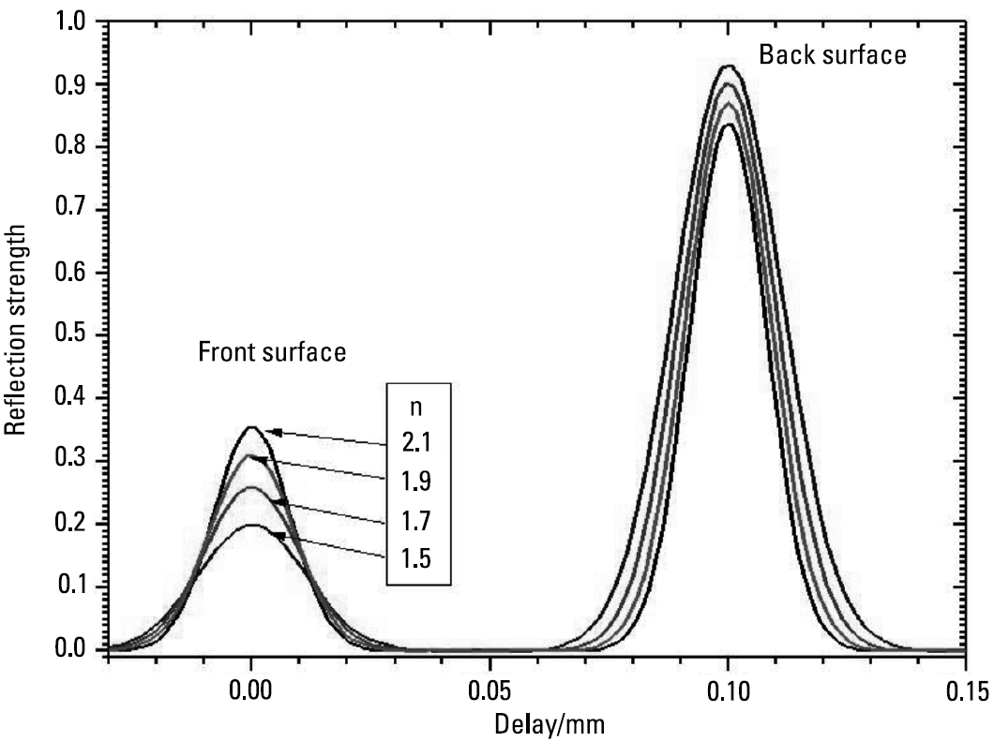
3. Imaging Thin Layers
First, the model takes into account only a single reflected pulse.
Material-Substrate
Air-Material

Slide 10
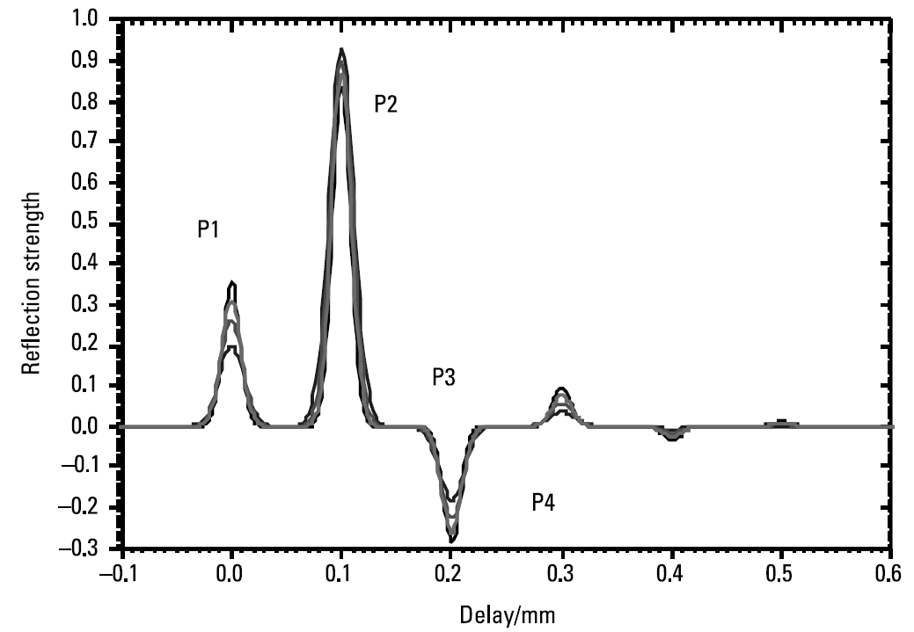
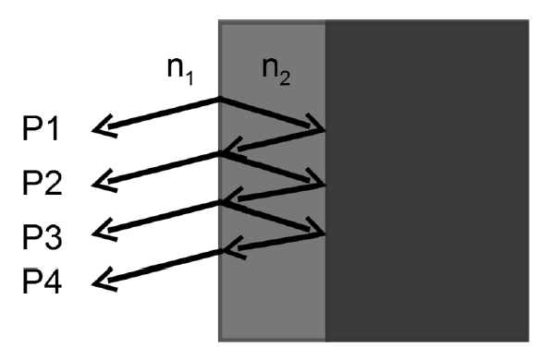
3. Imaging Thin Layers
In reality, multiple reflections occur.
Material-Substrate
Air-Material

Slide 11
Spatial Resloution Tests

Slide 12
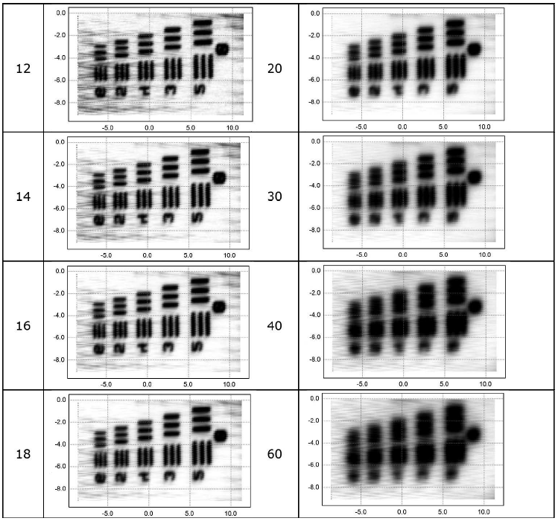
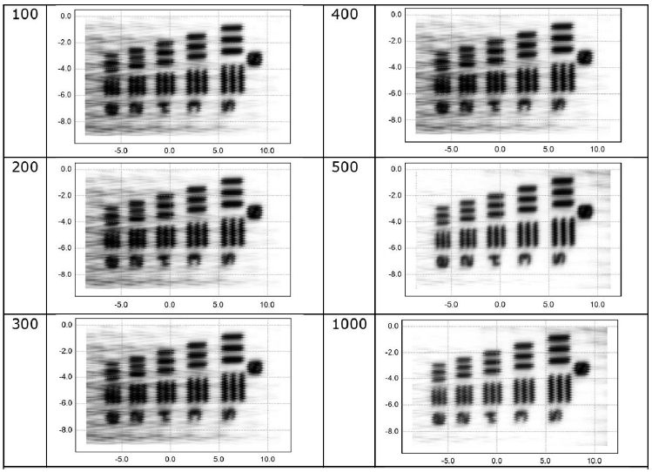
4. Spatial Resolution Tests
Increasing the HF ➔ reduction in the spatial resolution
Increasing the LF ➔ improve contrast

Slide 13
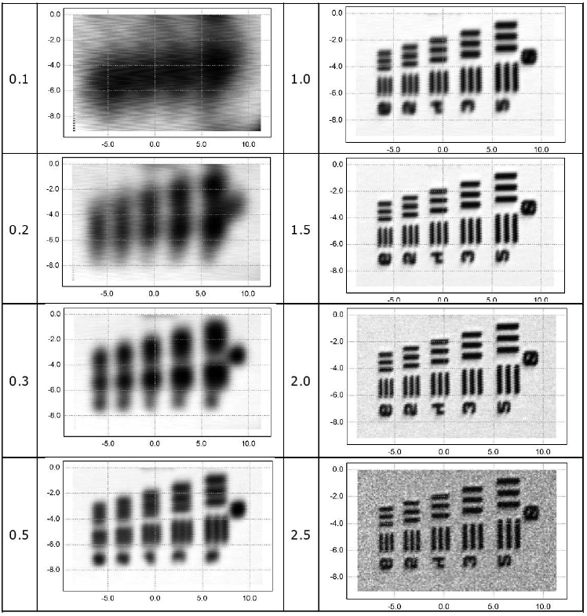
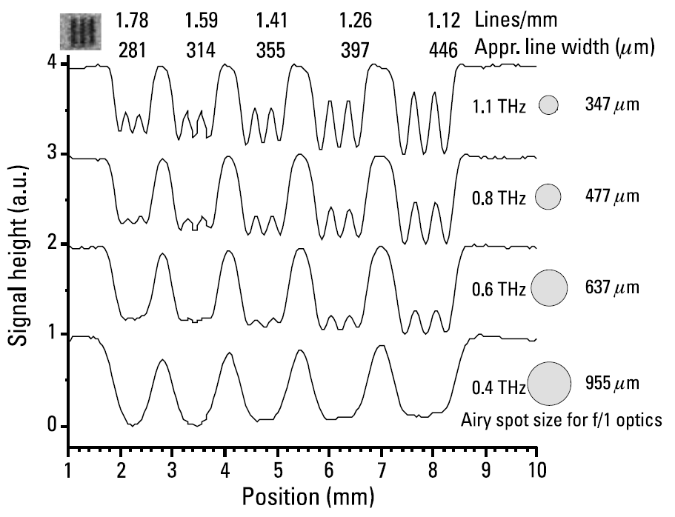
4. Spatial Resolution Tests
Below 0.5 THz, the lines are not resolved and cannot be seen.
The image at 2.5 THz, reduced SNR.

Slide 14
Near-Field Imaging

Slide 15
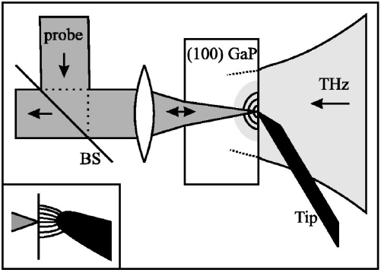
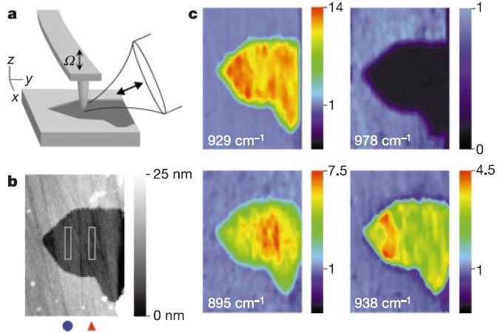
5. Near-Field Imaging
First applications restricted by necessity for the interactions to occur near the surface of the electro-optic crystal, thus limiting sample accessibility.
Recently developed, using aperture-less scattering scanning near-field optical microscopy, known as s-SNOM
Van der Valk, N. C. J., and P. C. M. Planken. “Electro-Optic Detection of Subwavelength Terahertz Spot Sizes in the Near Field of a Metal Tip,” Applied Physics Letters, Vol. 81, No. 9, 2002.
Hillenbrand, R., T. Taubner, and F. Keilmann, “Phonon-Enhanced Light-Matter Interaction at the Nanometre Scale,” Nature, Vol. 418, No. 6894, 2002.

Slide 16
Chemical Imaging

Slide 17
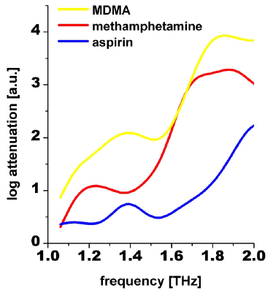
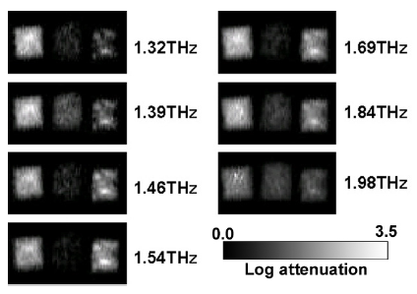
6. Chemical Imaging
Non-destructive drugs test
Kawase, K., etal., “Non-Destructive Terahertz Imaging of Illicit Drugs Using Spectral Fingerprints,” Optics Express, Vol. 11, No. 20, 2003.

Slide 18
Focal Plane Array
Microbolometer Cameras

Slide 19
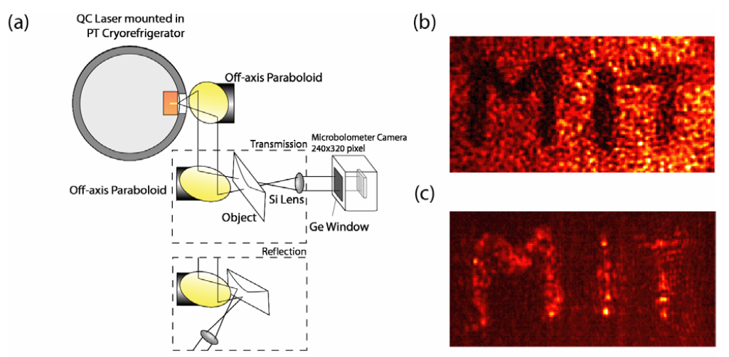
7. Focal Plane Array Microbolometer Cameras
Raster scan has limits the speed of image acquisition.
Transmission mode
Reflection mode
Lee, A. W. M., and Q. Hu, “Real-Time Continuous Wave Terahertz Imaging by Use of a Microbolometer FPA,” Optics Letters, Vol. 30, No. 19, 2005.

Slide 20
References
Aenchbacher, W., M. Naftaly, and R. Dudley, “Line Strengths and Self-Broadening of Pure Rotational Lines of Carbon Monoxide Measured by Terahertz Time-Domain Spectroscopy,” Applied Optics, Vol. 49, No. 13, 2010, pp. 2490-2496.
Hillenbrand, R., T. Taubner, and F. Keilmann, “Phonon-Enhanced Light-Matter Interaction at the Nanometre Scale,” Nature, Vol. 418, No. 6894, 2002, pp. 159-162.
Kawase, K., etal., “Non-Destructive Terahertz Imaging of Illicit Drugs Using Spectral Fingerprints,” Optics Express, Vol. 11, No. 20, 2003, pp. 2549-2554.
Lee, A. W. M., and Q. Hu, “Real-Time Continuous Wave Terahertz Imaging by Use of a Microbolometer FPA,” Optics Letters, Vol. 30, No. 19, 2005, p. 2563.
Molloy, J. F., et al., “Dispersion Properties of GaS Studied by THz-TDS,” Cryst. Eng. Comm., Vol. 16, 2014, pp. 1995-2000.
Van der Valk, N. C. J., and P. C. M. Planken. “Electro-Optic Detection of Subwavelength Terahertz Spot Sizes in the Near Field of a Metal Tip,” Applied Physics Letters, Vol. 81, No. 9, 2002, pp. 1558-1560.

